Slide 1
Introductory General Chemistry
Chemistry 3A
Experiment 4b
Rolling for
Compound Initiative
Mitch Halloran

Slide 2
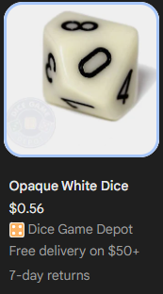
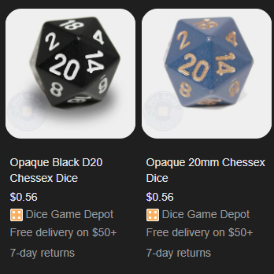
Introduction
The “Language of Chemistry” is our purpose here
Decahedral (10-sided) and Icosahedral (20-sided) dice will be used to generate names for chemical compounds in this experiment
These are actually online dice provided by Google

Slide 3
Background: Identify Compound Type
We talked about chemical compound naming in lecture. In this experiment, your knowledge & learning are reinforced.
Identifying Compound Type
Ionic compound
  metal elements are the cations (positively charged ions)
  nonmetal elements are the anions (negatively charged ions)
  They are ionic compounds because the bonds are ionic
  Ions can be
    Monatomic (single element): 𝑁𝑎⁺,𝐶𝑙⁻,𝐹𝑒³⁺, etc.
    Polyatomic (many elements): 𝑁𝐻₄⁺, 𝑁𝑂₃⁻, PO₄³⁻, 𝐶₂𝐻₃𝑂₂⁻, etc.

Slide 4
Background: Identify Compound Type
Identifying Compound Type (cont.)
Molecular Compound
  In contrast to ionic compounds, these are not electrically charged (not ions!)
  Composed of nonmetal element bonded to each other by the sharing of valence shell electrons (covalent bonds)
Acid
  Acids are substances that can donate protons (H⁺ ions)
    This is the definition of Bronsted-Lowry. There is another definition called a Lewis acid, which an element/compound that can accept an electron pair, but you don’t need to know this
  The reaction is HA ←→ H⁺ + A⁻, where A is a nonmetal or polyatomic substance that will be an anion

Slide 5
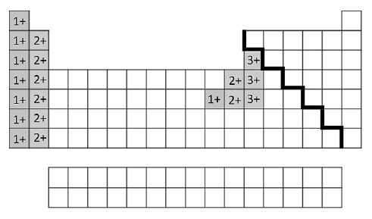
Background: Rules for Naming
Ionic compounds
Type I metal cations + polyatomic cation
  all Group 1 and 2 elements
  Group 13: Al³⁺, Ga³⁺ (gallium)*, In³⁺ (indium)**
  Group 12: Zn²⁺, Cd²⁺
  Group 11: Ag⁺
  Polyatomic: ammonium
With monatomic and
polyatomic anions
  Monatomic:
  Nonmetal stem + -ide
  Polyatomic:
  suffix usually –ite or -ate
* Gallium is considered Type I despite having a rare Ga⁺ (1+) state
** Indium is considered Type II as it has a bonafide 1+ and 3+ state

Slide 6
Background: Rules for Naming
Ionic compounds
Type II metal cations
  All metal elements NOT a Type I cation
  Element name + Roman numeral for charge
With monatomic and polyatomic anions
  Monatomic: Nonmetal stem + -ide
  Polyatomic: suffix usually –ite or -ate

Slide 7
Background: Rules for Naming
Molecular compounds
Add a prefix indicating count of element atoms to the first and second elements
2nd element gets suffix –ide
* mono- prefix omitted for 1st element name
Number | Prefix |  | Number | Prefix
1 | *mono- |  | 6 | hexa-
2 | di- |  | 7 | hepta-
3 | tri- |  | 8 | octa-
4 | tetra- |  | 9 | nona-
5 | penta- |  | 10 | deca-

Slide 8
Background: Rules for Naming
Protic Acids with Monatomic Anions
(acids donating H⁺)
Add the prefix hydro-
Then add root name of (nonmetal) element
Then add suffix –ic followed by word acid
Hydrochloric acid, hydrobromic acid, hydroiodic acid
Oxyacids in polyatomic anions
Polyatomic anion ends in –ate:
Change suffix to –ic add acid
H₂SO₄ sulfuric acid
Polyatomic anion ends in –ite:
Change suffix to –ous add acid
H₂SO₃ sulfurous acid

Slide 9
Equipment You Will Use
None of the usual equipment and consumables of the chemistry laboratory will be utilized in this experiment
You will use your Canvas account to find the Experiment 4b Assignment and go through the feature to assist you in completing the report

Slide 10
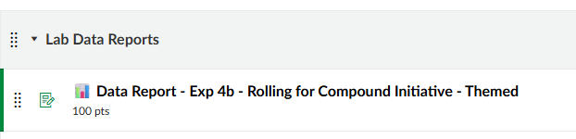
Canvas-Find Assignment
In Canvas, look in Assignments for Lab Data Reports, and look for Data Rep
Select (click on) the assignment

Slide 11
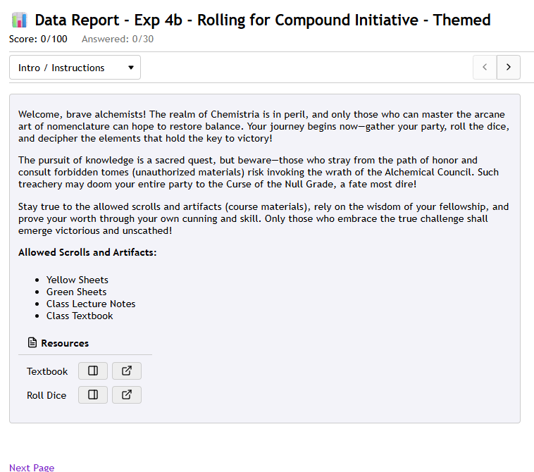
Canvas-Open First View
The first page just tells you about the experiment and it provides links to your textbook if you wish to use it and to the Google dice roller, which will be demonstrated to you

Slide 12
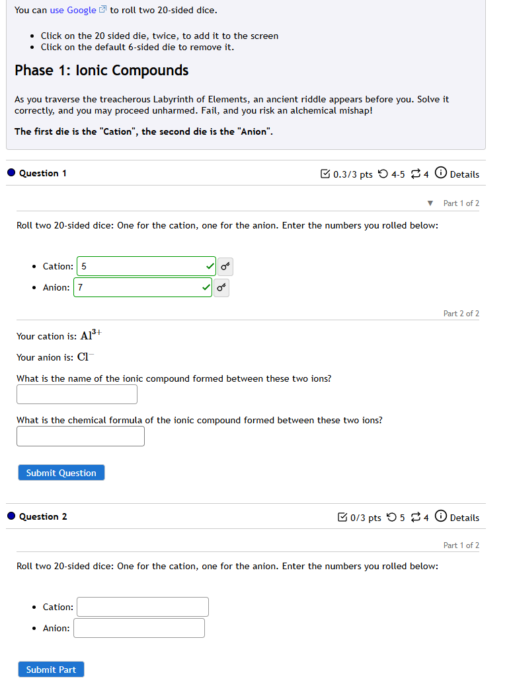
The subsequent pages will be interactive forms that allow you to put dice rolls values into entries to generate random cations and/or anions. You will use these to build chemical formulas and to test your ability to name compounds
The form will check/validate your responses as correct

Slide 13
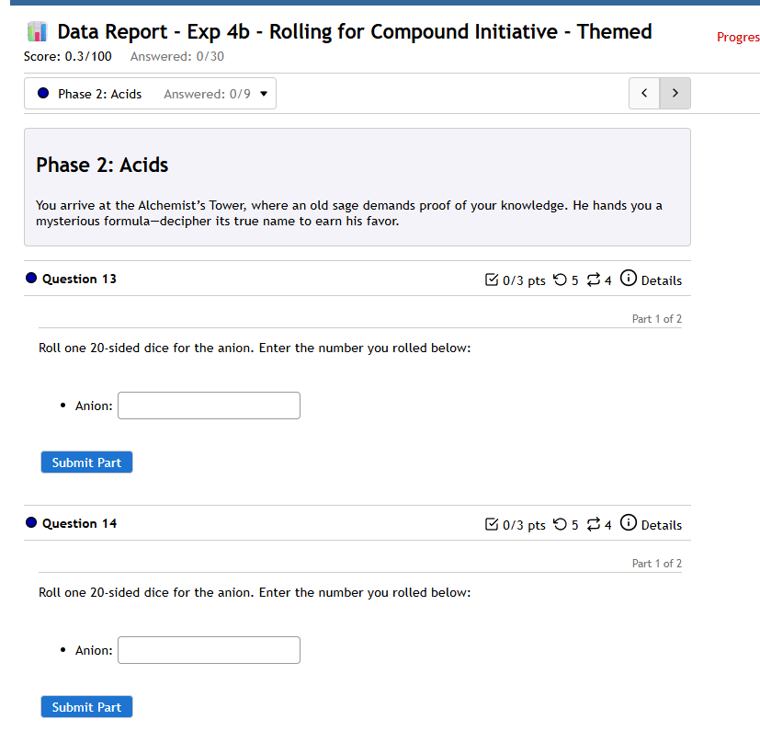
As you work through the pages of the form, you will record your results in your regular lab manual
There are some things you need to fill out that are not in the form, such as Type I or Type II cations, and other data

Slide 14
Clean Up
No clean up was required for this experiment

Slide 15
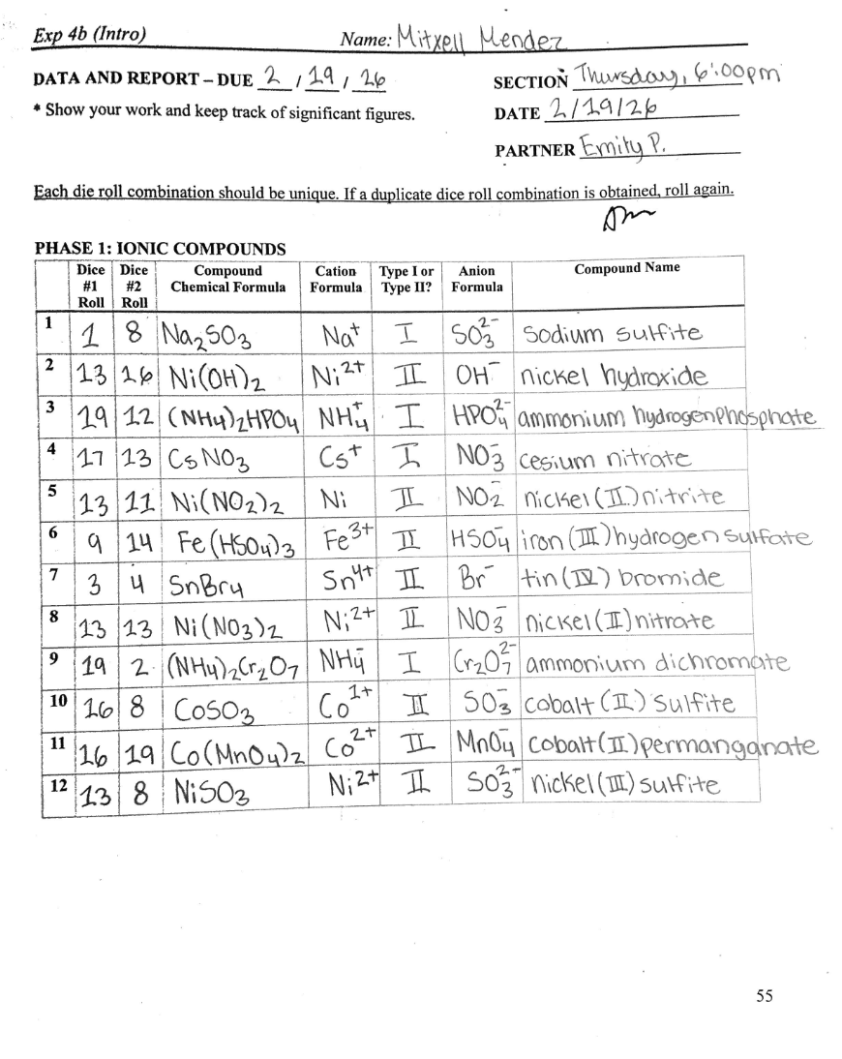
Example Report

Slide 16
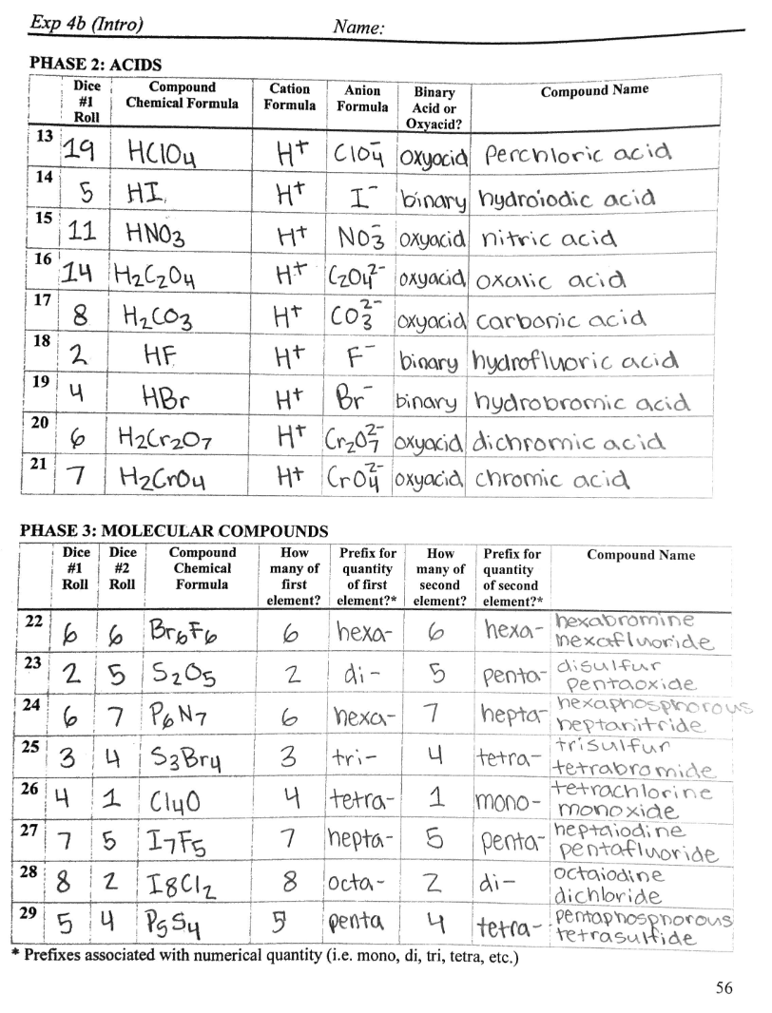
Example Report

Slide 17
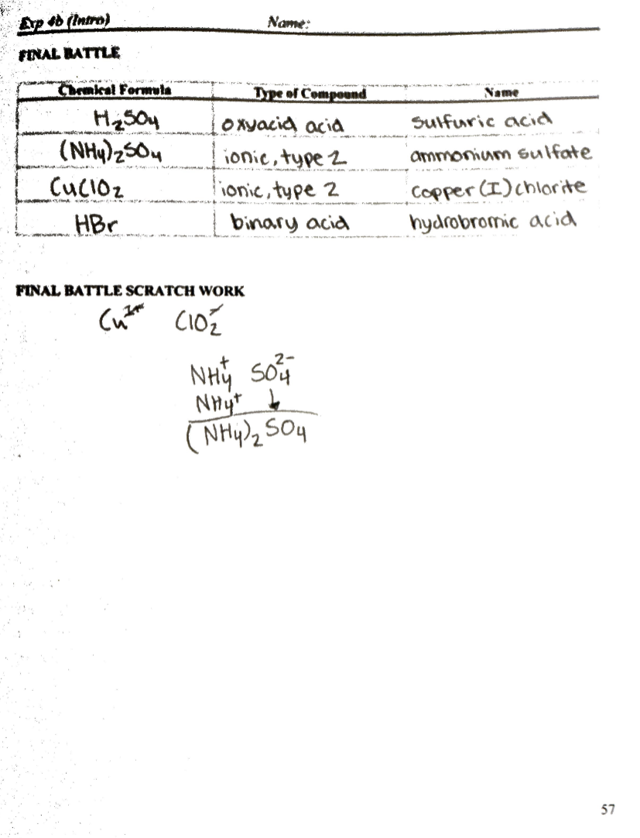
Example Report

